Slide 1

2026 MACSYS International Scientific Advisory Board Meeting

Slide 2
About the ISAB
Purpose & Responsibilities
The International Scientific Advisory Board (ISAB) contributes to the development of scientific strategies and vision for MACSYS. It assists executive management in shaping the strategic research direction, offers an international perspective on the research field, and undertakes international benchmarking — providing invaluable advice on opportunities for new intellectual property, commercialisation and other translation outcomes.
Key responsibilities
Advising on the scientific direction of MACSYS research and translational activities
Shaping research focus at the forefront of whole-cell modelling for impact in academia and beyond
Identifying stronger linkages between academia, industry, government and other sectors
Providing an international perspective and benchmarking, at least biennially
Contributing to the annual review and development of the strategic research plan, including Strategic Initiatives Fund priorities

Slide 3
ISAB Membership & Procedures
Terms of Reference 2025
Membership
4–6 independent members (including the Chair)
MACSYS Director
MACSYS Chief Operating Officer
Chair, Strategic Research Committee
Chair, Translation & Partner Engagement Committee
Independent members are appointed for terms of up to two years
Meeting Procedures
Meets at least once a year, by video conference
Additional meetings may be convened in person and/or virtually
The ISAB's role is advisory only — its resolutions are not binding

Slide 4
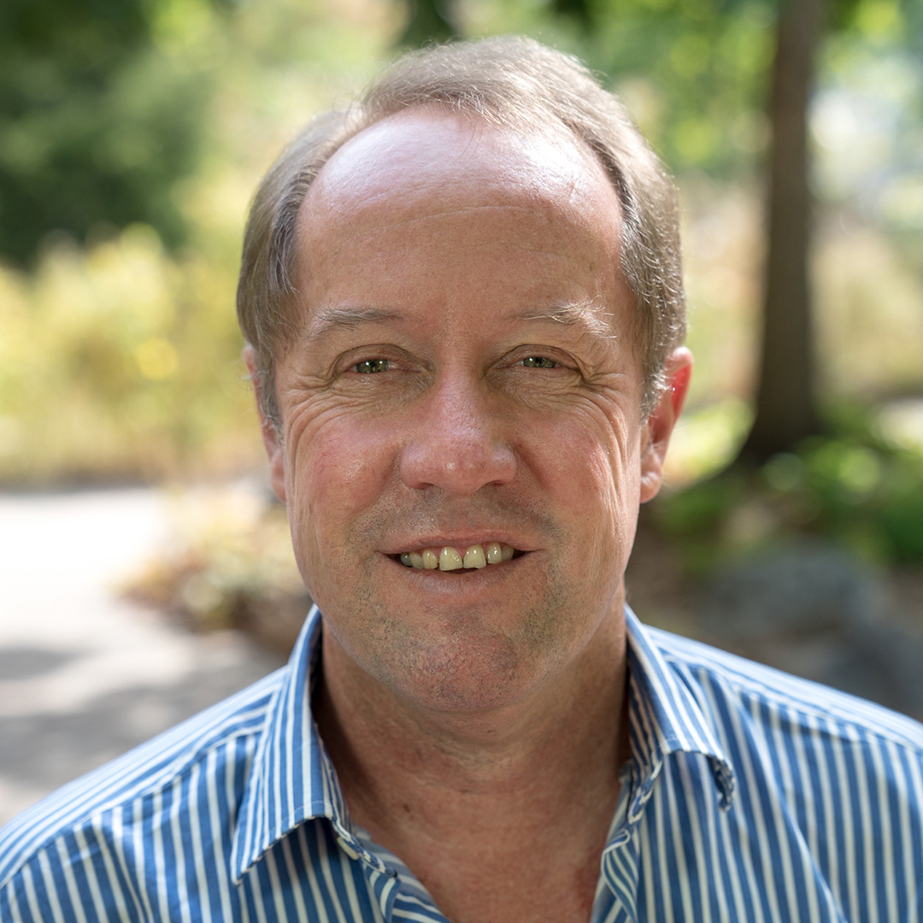
Hugh Possingham
Chair, International Scientific Advisory Board | Emeritus Professor, University of Queensland
Vice-Chancellor’s Senior Research Fellow, UQ Centre for Biodiversity and Conservation Science
Formerly held ARC Professorial, Laureate & Federation Fellowships in Mathematics, Zoology and the School of the Environment
Co-developed Marxan, a widely used global conservation spatial-planning tool
Queensland Chief Scientist, 2020–2022
Foreign Associate, US National Academy of Sciences; Fellow, Royal Society

Slide 5
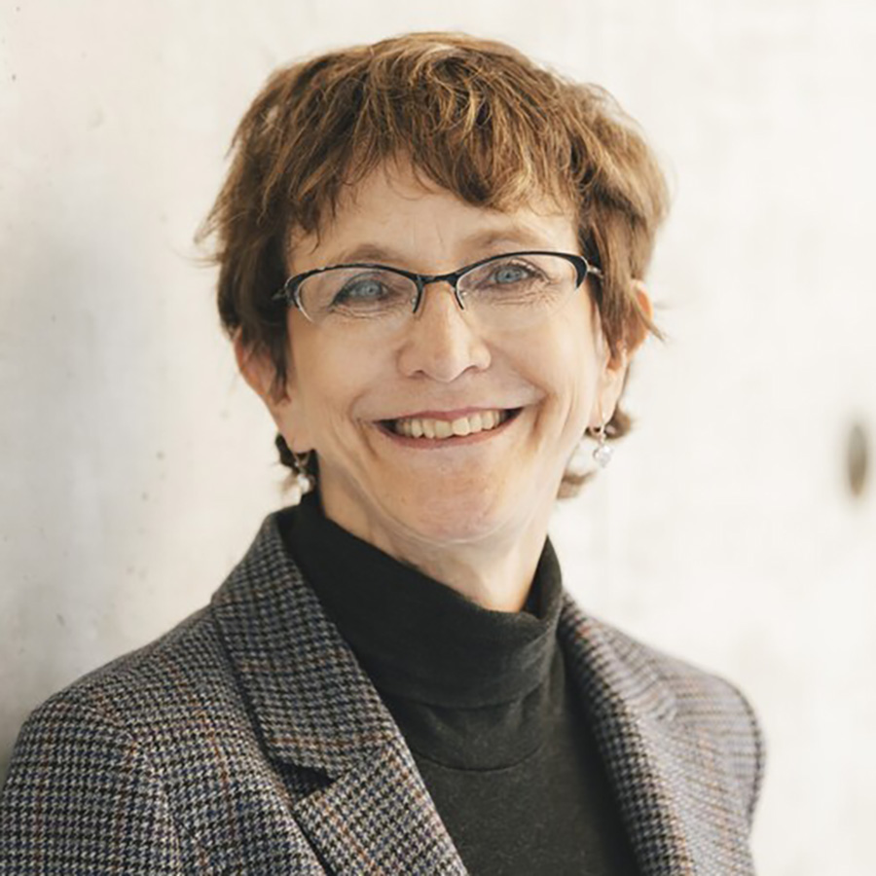
Brenda Andrews
Independent Member | University Professor & Canada Research Chair, University of Toronto
University Professor & Canada Research Chair in Systems Genetics and Cell Biology, Donnelly Centre, University of Toronto
Research spans cellular signalling and genetic networks in yeast, using functional genomics and high-content screening
Created the first complete genetic interaction map for a model eukaryotic cell
Companion of the Order of Canada
Fellow, Royal Society of Canada & American Academy of Microbiology; International Member, US National Academy of Sciences

Slide 6
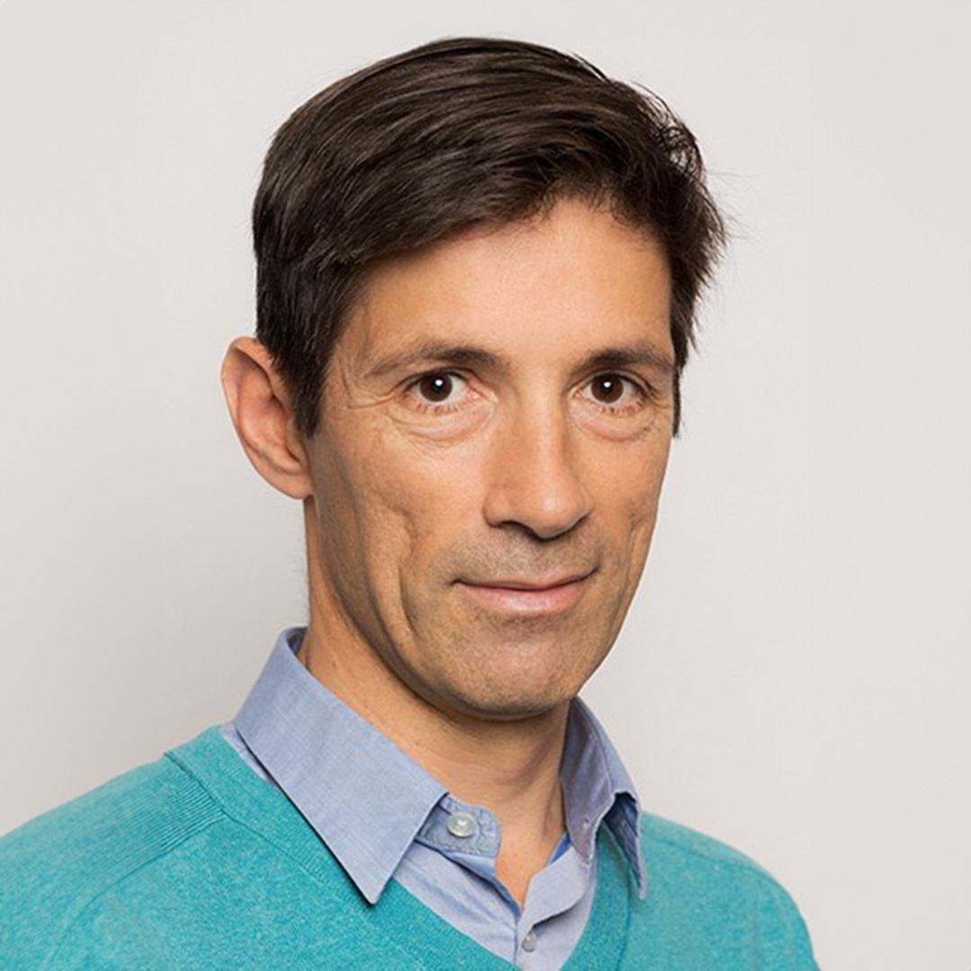
Thomas Lecuit
Independent Member | Dynamics of Life Chair, Collège de France
Dynamics of Life Chair, Collège de France
Leads a research team at the Institut de Biologie du Développement de Marseille
Director, Turing Center for Living Systems
Research focuses on the physical and mathematical principles governing cell growth, division, shape and organisation
Fellow, French Academy of Sciences; elected member, European Molecular Biology Organization

Slide 7
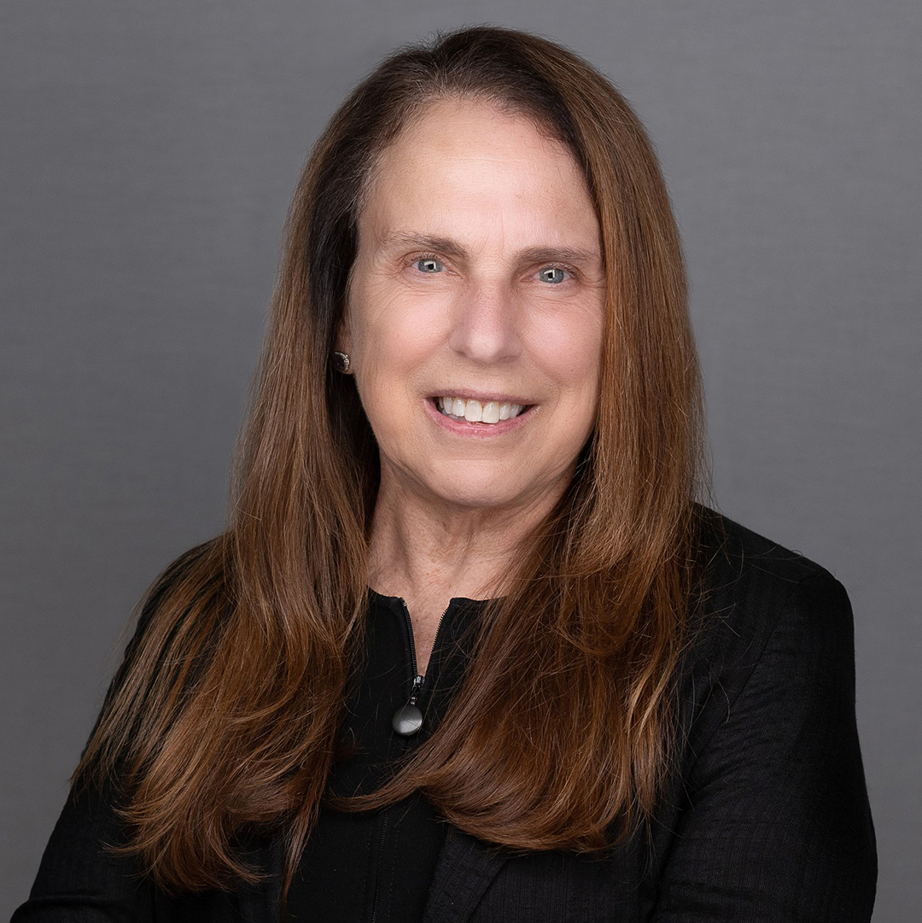
Pamela Silver
Independent Member | Elliot T. and Onie H. Adams Professor, Harvard Medical School
Elliot T. and Onie H. Adams Professor of Biochemistry and Systems Biology, Harvard Medical School
Founding member, Department of Systems Biology, Harvard Medical School
Builds synthetic cells for sensing, memory, bio-computing and production of high-value compounds and energy
Notable innovations include gut-inflammation-sensing bacteria and the Bionic Leaf
Member, US National Academy of Sciences; first Director, Harvard University Graduate Program

Slide 8
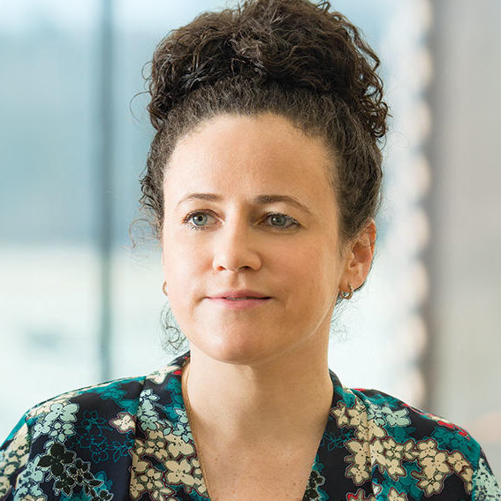
Olga Troyanskaya
Independent Member | Professor of Computer Science & Genomics, Princeton University
Maduraperuma/Khot Professor of Computer Science & Genomics, Princeton University
Founding Director, Princeton Precision Health
Deputy Director for Genomics, Flatiron Institute of the Simons Foundation
Develops AI and data-driven methods to decode the genome and enable precision medicine — spanning autism, cancer and kidney disease
Honours include the Sloan Research Fellowship, an NSF CAREER Award, and the Overton Prize (ISCB)

Slide 9
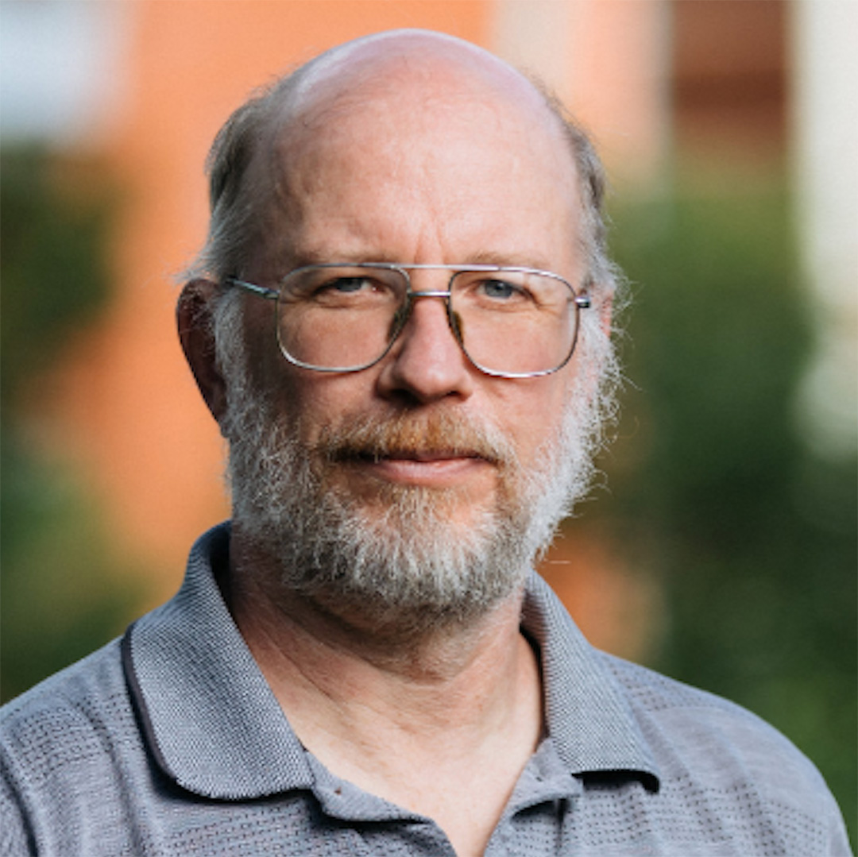
David Wishart
Independent Member | Distinguished University Professor, University of Alberta
Distinguished University Professor, University of Alberta (Biological Sciences & Computing Science)
Research spans metabolomics, analytical chemistry, molecular biology and neuroscience
Developed widely used NMR, mass spectrometry and chromatography techniques
Pioneers AI/ML methods for identifying unknown metabolites and metabolic pathways
Fellow, Royal Society of Canada; former Chair, Metabolomics Australia ISAB

Slide 10
Meeting Agenda
Wednesday 12 August 2026 | 5:00–8:00am AEST | Video Conference
5:00 Welcome & Centre Overview — Prof Jen Flegg, Strategic Research Committee Chair (15 min)
5:15 Research Fellow Presentations & ISAB Q&A (15 min presentation + 10 min Q&A each)
5:15 — Dr Alex Sneddon, ANU
5:40 — Dr Hilary Hunt, QUT
6:05 — Dr Josh Hamey, UNSW
6:30 — Dr Anthony Hart, Monash
6:55 — Dr Tom Kimpson, University of Melbourne
7:20 Open Discussion & Wrap-up (40 min)
8:00 Meeting Concludes

Slide 11
Meeting Purpose
Wednesday 12 August 2026 | 5:00–8:00am AEST | Video Conference
Purpose
  to seek the ISAB’s feedback and advice on MACSYS research aims, activities and projects.
  Set priorities for Strategic research in 2027
Format: short presentations from research fellows, with time for ISAB questions and feedback after each
Questions?

